Slide 1
Today you will become experts on great horned owl adaptation. Take notes along the way using the blank Adaptation Sheet. Read the questions on the powerpoint and discuss your ideas. Use the pictures and videos to help guide your answers. Then read the facts and don’t forget to write down some notes on the owl adaptation sheet!

Slide 2
Great Horned Owl Adaptations

Slide 3
Imagine that you are in the ocean, surrounded by by underwater creatures.
What are some things those underwater creatures have on their bodies that help them survive in their ocean habitat? (click when ready to reveal examples)
Examples: gills, shell, fins, tentacles

Slide 4
All of these things are called adaptations!
An adaptation is something an animal or plant has or does that helps them live in their habitat (a place where an animal lives).
Think about what adaptations an owl has that helps them survive.

Slide 5
Eyes
What time of day do owls hunt?
Look at the eye sockets of the owl skull. What do you notice about them?

Slide 6
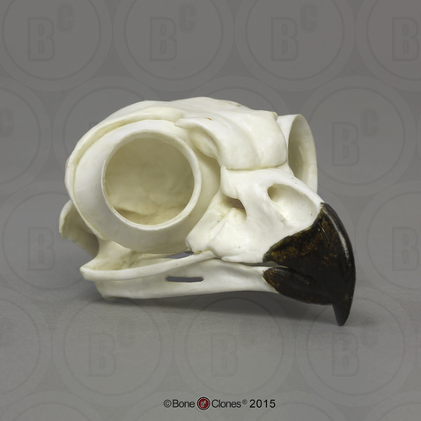
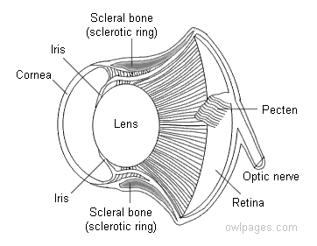
Owl Eye
Great Horned Owl Skull

Slide 7
Eyes
Great horned owls have large eyes that do not move in their sockets. They are held in place by the scleral bone (see image on previous slide).
Eyes are filled with cells that are sensitive to light called rods and cones - just like our eyes. Cones help us see color, and rods help us see in dim light. What type of cells do you think great horned owls have more of?
Answer: They have many rods, giving them excellent night vision.
They have “binocular vision” which means both of the eyes work together to give one big picture. This helps the owl to judge distance, how fast prey is moving, and how big it is.
They have three eyelids - the upper eyelid closes when the owl blinks, the lower eyelid closes when the owl is asleep, and the third eyelid is called a nictitating membrane which is a thin layer of tissue that helps to clean and protect the owl’s eyes.

Slide 8
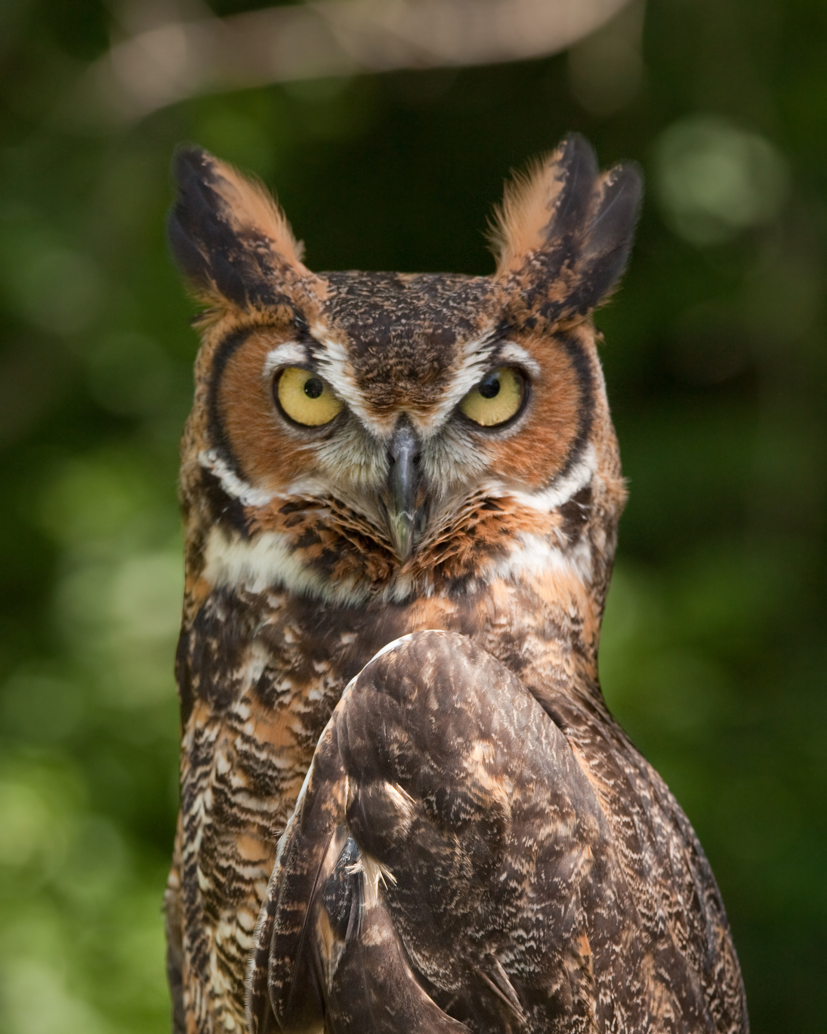
Ears
Where do you think the ears of the great horned owl are located?

Slide 9
Ears
Great horned owls have a special way to listen for prey! They have asymmetrical ears, which means that the right ear is higher than the left ear, so sound arrives at one ear before it arrives at the other. When an owl hears a mouse scurrying on the ground, it will pick up the sound in one ear first. The owl tilts its head so that the noise reaches both ears at once to locate its prey before pouncing.
Their ears are on the sides of their skull and are hidden under feathers. They are not under the feather tufts on the top of the head.
They can hear a mouse moving under a foot of snow!

Slide 10
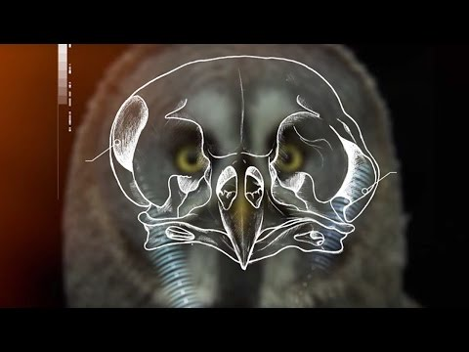
How does an Owl’s Hearing Work?

Slide 11
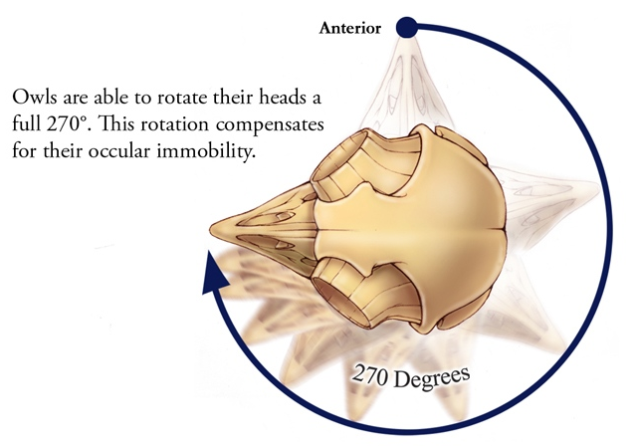
Neck/Head Rotation
How far can you turn your head (carefully!)?
Owls can turn their head 270 degrees in each direction - how do you think they can do this?
How does the ability to
turn their head help an owl survive?

Slide 12
Neck/Head Rotation
We can only rotate our heads around 80 degrees...but owls are able to rotate their heads 270 degrees in both directions! How? Great horned owls have 14 neck bones - twice the number that we have. Their eyes are locked in place and don’t move like ours do, but their special ability to rotate their head more than halfway around their body helps owls see things behind them!
Watch this video to learn more about how and why they turn their heads so far around

Slide 13
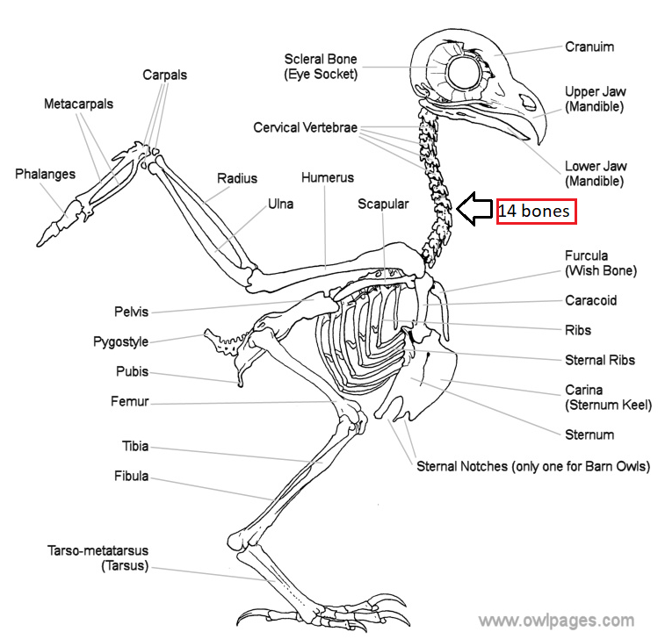
The 14 bones in the owl’s neck allow it to turn 270°

Slide 14
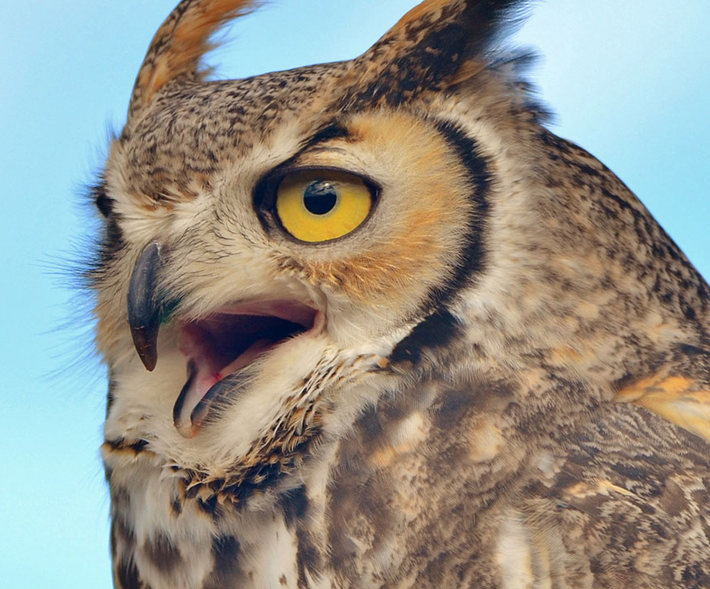
Beak
What do you notice about the size and shape of the great horned owl’s beak?
What do you think they use their beak for?
How do you think owls use their sense of smell?

Slide 15
Beak
This owl has a downward-facing beak that is hooked at the end.
Their beaks are adapted for ripping and tearing meat.
If the owl is annoyed, it might make “clicking” noises with its beak as a warning.
Great horned owls do not have a good sense of smell. Instead, they use other adaptations (such as their eyes and ears) to locate prey. This also means that they will even eat skunks!

Slide 16
Feathers
You can see an owl fly, but you will rarely ever hear them. Why do you think this is?
Look at the feathers. What do you notice about them? How are they different from each other?

Slide 17
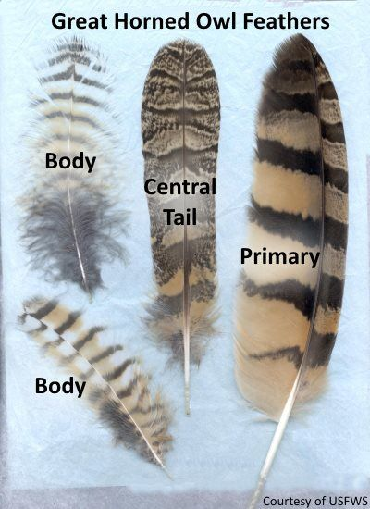
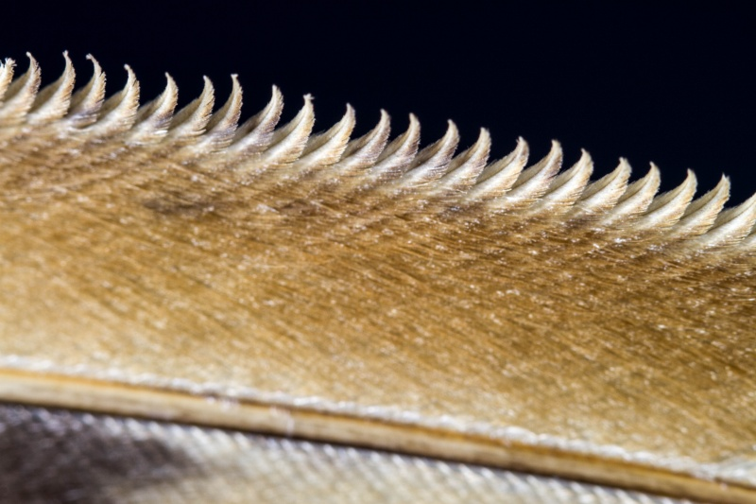
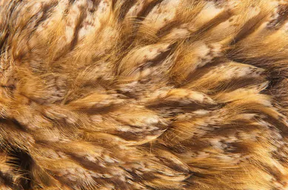

Slide 18
Feathers
Owls have special feathers that help them fly silently and sneak up on prey when they are hunting. Flight feathers have comb-like edges that break up the air when the owl is flying so they don’t make the “whooshing” sound like most bird wings do. The surface texture of the feathers is velvety and soft which helps absorb the sound too. Prey won’t hear them coming!
Great horned owls can easily carry large prey because they have light bodies and large, powerful wings.

Slide 19
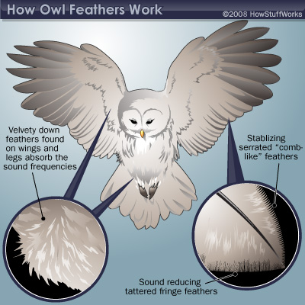

Slide 20
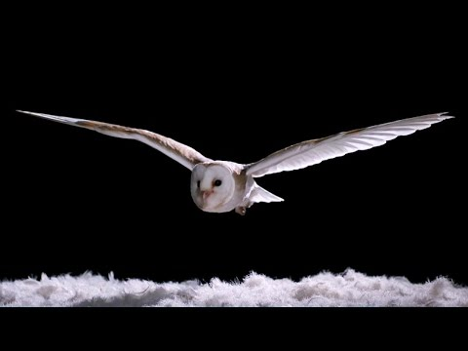
How Does an Owl Fly so Silently?

Slide 21
Camouflage
Have you ever seen an owl in the wild before? They are hard to spot - especially in the daytime. Why do you think this might be?
Take a look at the pictures. How many owls can you spot on each page?

Slide 22
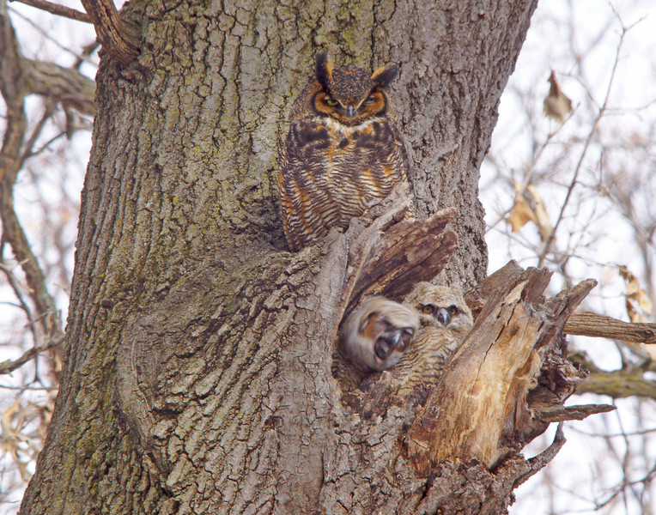
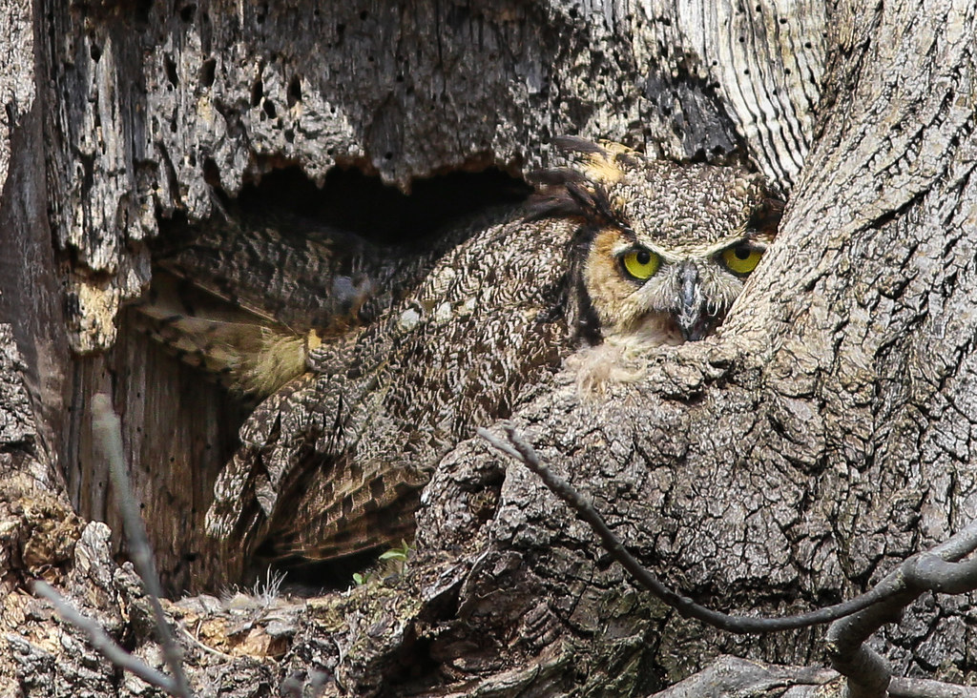

Slide 23
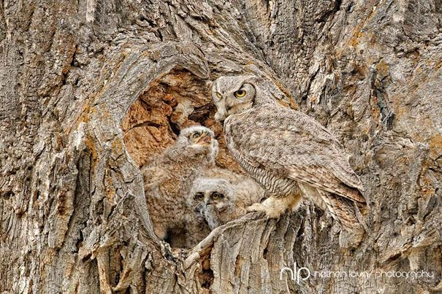
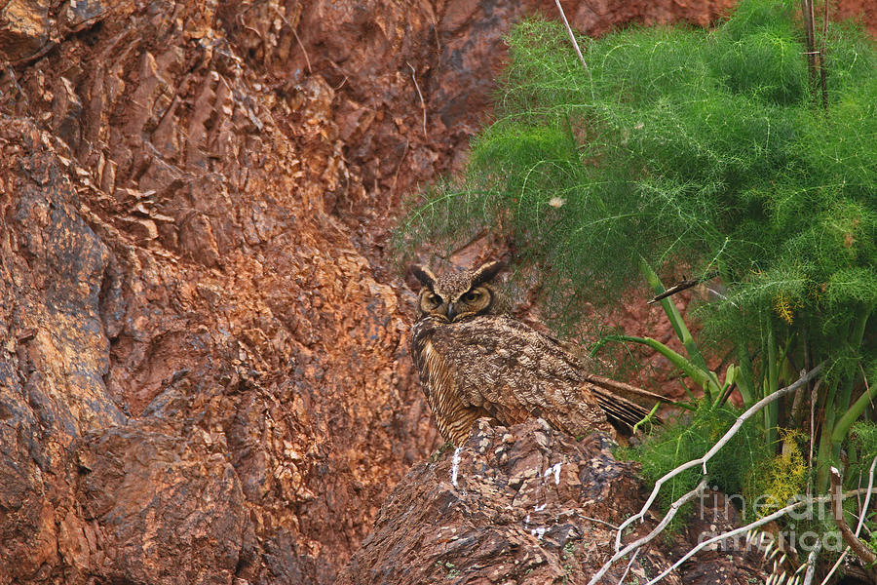

Slide 24
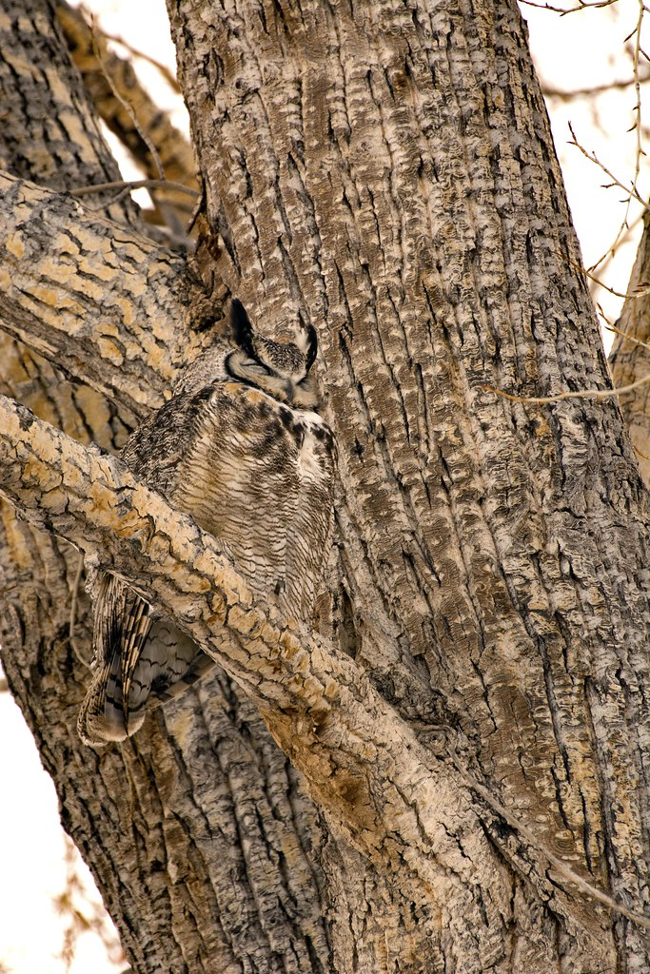

Slide 25
Camouflage
Great horned owls are masters in disguise!
Their feathers are brown or dark grey which helps them blend into the trees that they roost in during the day.
See the big tufts on their face? They’re not ears - those tufts break up the circular shape of their face so they can blend into the branches of trees.

Slide 26
Nocturnality
Some animals hunt during the day and some hunt at night. What are the advantages of hunting at night?
What are the challenges of hunting at night?
What adaptations could help an animal that hunts at night?

Slide 27
Nocturnality
Great horned owls are nocturnal animals - they typically hunt for food in the evening and at night. By hunting at night, they don't have to compete with other birds of prey that hunt for food in the daytime.
When it is dark, the owl’s prey cannot see them as well.
Nocturnal animals must have adaptations to see in the dark, stay warm in the cold, and be quiet.

Slide 28
Calls
Have you ever heard an owl? What does it sound like?
Why do you think owls make calls or hoots?

Slide 29
Calls
Great horned owls are most well known for making a “hoo, hoo, hoo, hoo” call, which they use to communicate with each other.
They will can also make a clacking sound with their beak when they are upset or disturbed.
Baby owls make a screaming sound when begging for food.
Listen to their sounds here

Slide 30
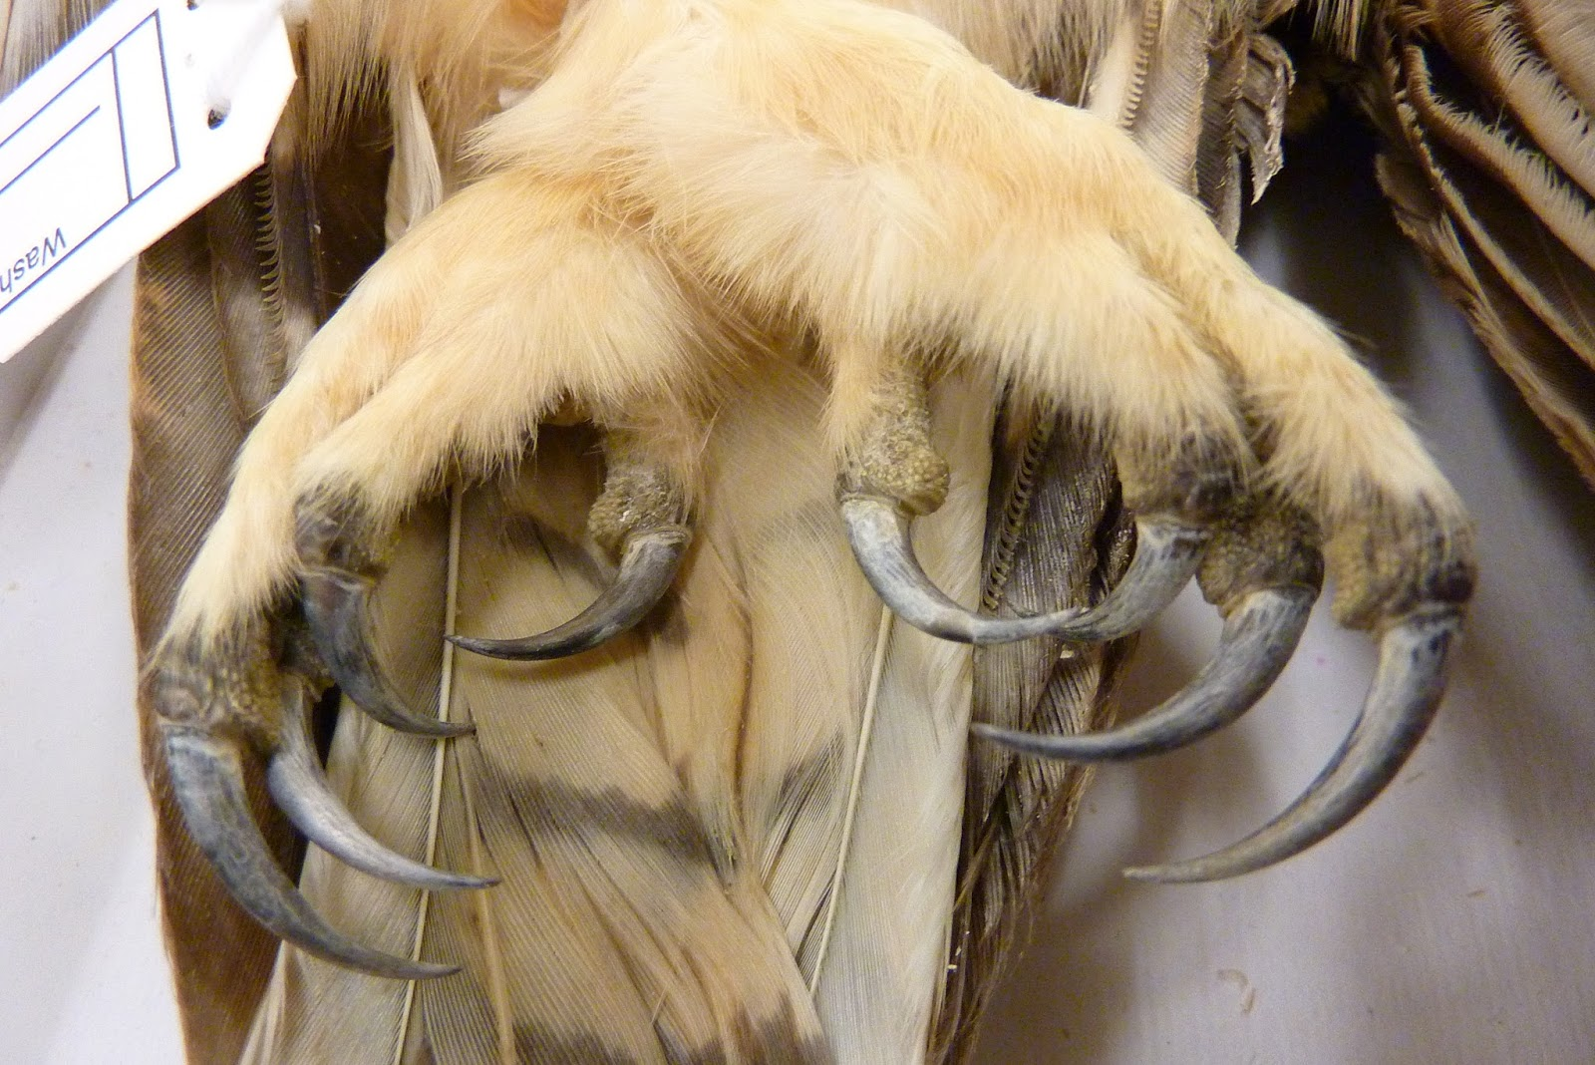
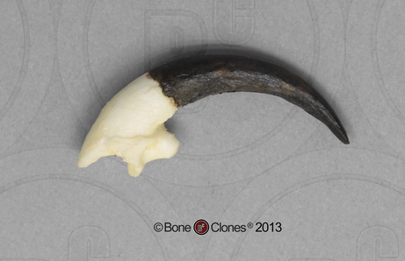
Talons/Feet
What do you think the talons are useful for?
What do the talons remind you of?
Why do you think the owl has feathers on its feet?

Slide 31
Talons/Feet
Owls have 4 toes that help them grip onto branches and balance. 2 toes face forward, 1 backward, and then the last 1 can move to face forward or backward. There is a sharp claw, or talon at the end of each toe.
Great horned owls have a strong grip! It takes 28 pounds of force to open when they are clenched. Their strong grip allows them to crack the spine of large prey, and to carry animals that are bigger and heavier than themselves.
They use their talons to capture and kill prey, but also to protect themselves against predators.
Their feet have feathers on them to keep warm.

Slide 32
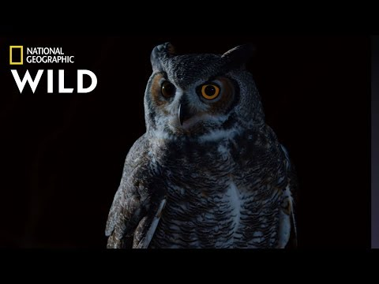
Great Horned Owl on the Hunt

Slide 33
Post Discussion
Some adaptations are structural and some are behavioral. A structural adaptation is something an animal has on its body. Behavioral adaptations are things that an animal does to survive.
What is an example of a structural adaptation of a great horned owl? What is an example of a behavioral adaptation?
Go through each adaptation on your great horned owl adaptation sheet and sort them into either behavioral or structural adaptations.

Slide 34
Further Discussion
How are the adaptations of the great horned owl different from the adaptations of a hawk (or other bird that hunts in the daytime)?
What do you think is the great horned owl’s best or most important adaptation? Why?

