Slide 1
Plant Growth Observations
Click on the speaker icon to listen to the audio version of the slide

Slide 2
Today we are going to think about what plants need to grow.
What do you think plants need to grow?

Slide 3
We are going to look at different pictures that show plants growing during the 4 seasons. We are going to make observations about what is different and how that might affect plants and their growth.
What changes do you notice with the seasons?
Fall
Winter
Spring
Summer

Slide 4
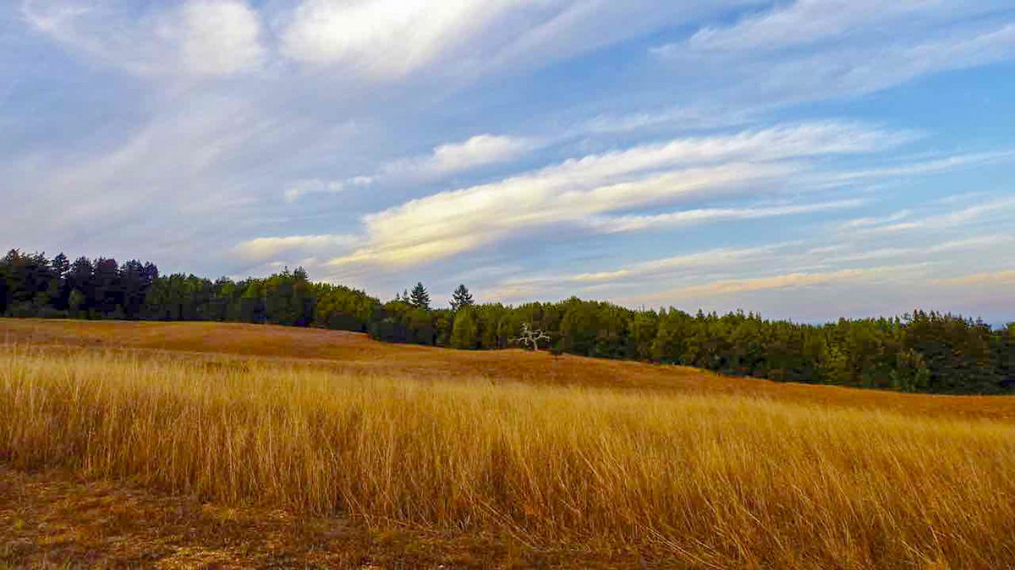
What do you notice about plants in the summer?
What is the weather like in the summer?
It doesn’t usually rain in the summer.
The days are longer, which means more sun and warmer temperatures.

Slide 5
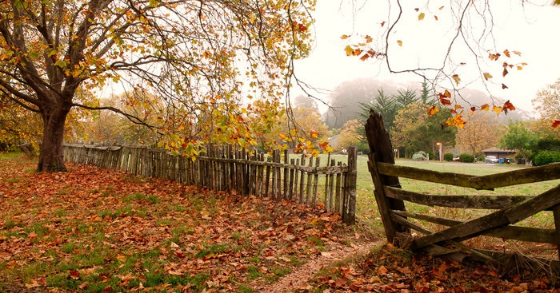
What do you notice about plants in the fall?
What is the weather like in the fall?
It gets colder in the fall.
The days are shorter than in the summer, which means there is less sun.

Slide 6
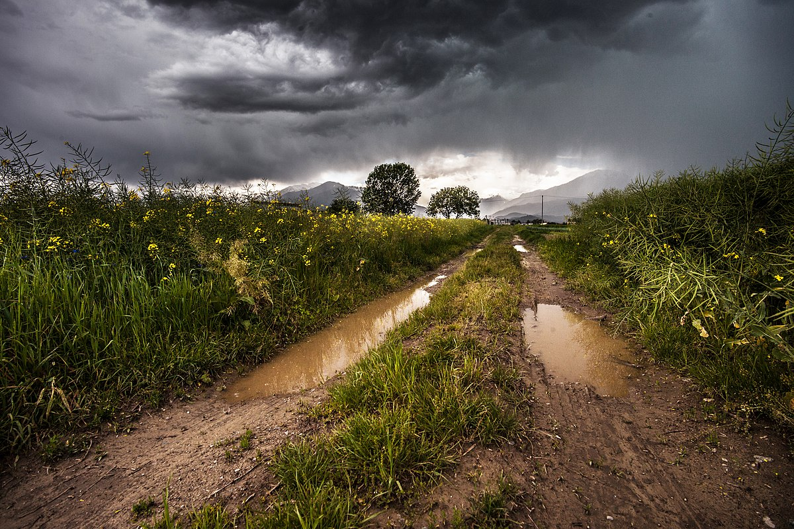
What do you notice about plants in the winter?
What is the weather like in the winter?
It rains more in the winter.
The days are short, so there is not much sun.

Slide 7
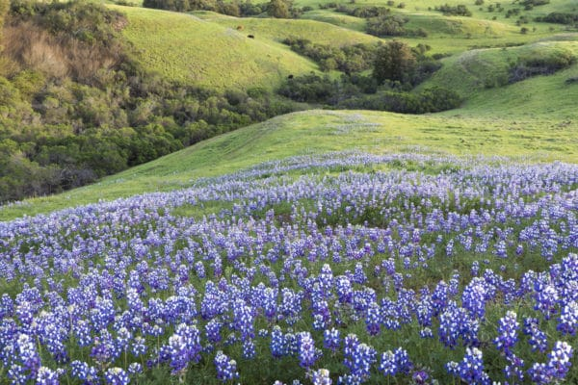
What do you notice about plants in the spring?
What is the weather like in the spring?
It rains more in the spring.
The days are longer than during winter, which means more sun.

Slide 8
Think about the 4 seasons and the photos you just saw.
In which season did you notice the most growth? Why?
I noticed that spring had the most growth. I think this because during spring it rains a lot and the sun shines for more hours.

Slide 9
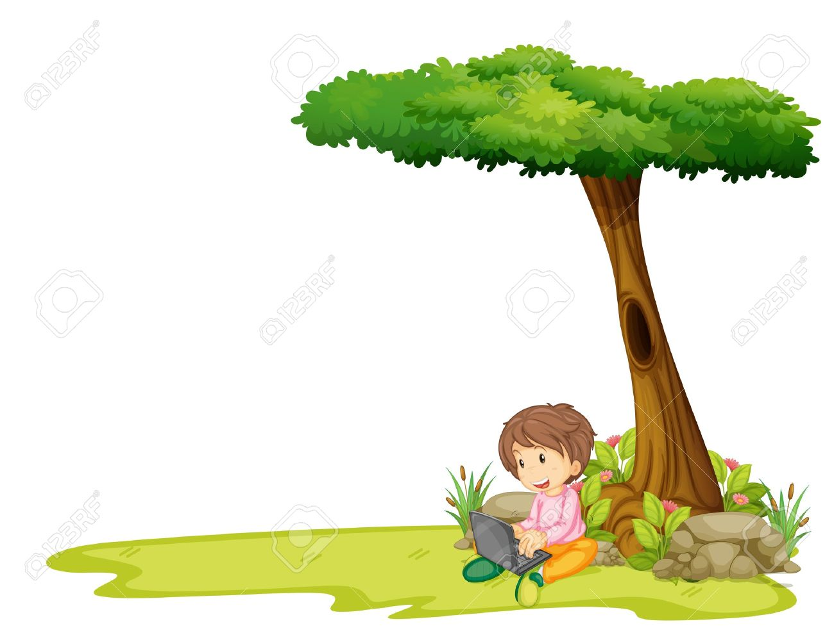
go outside or look out your window
What season is it?
What do you notice about the plants growing around where you live? Are they in places that gets lots of sun or water?
Spring!
I notice the plants in the shade are smaller than the plants in the sun.

Slide 10
What do you think plants need to grow?
Plants need water, sunlight, and soil to grow.
Think about where plants might grow well around where you live, and maybe even try growing a plant yourself!

